Slide 1
FIT3157 Assignment 2 Progress
Kelvin Kwok
Matt Sturgeon

Slide 2
Artist and Research

Slide 3
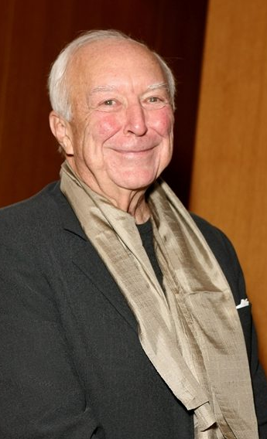
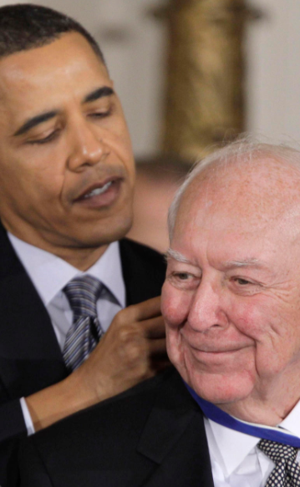
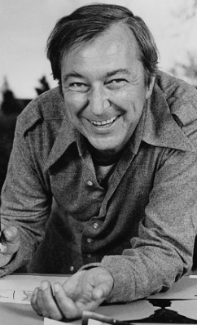
Jasper Johns
Paintings
Prints
Sculptures

Slide 4
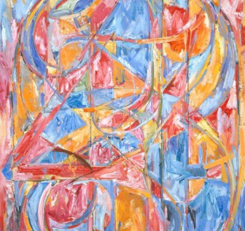
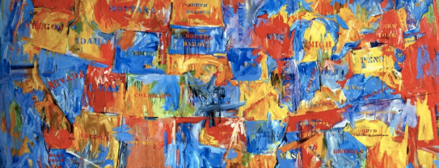
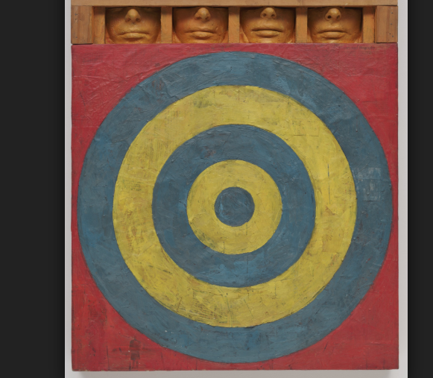
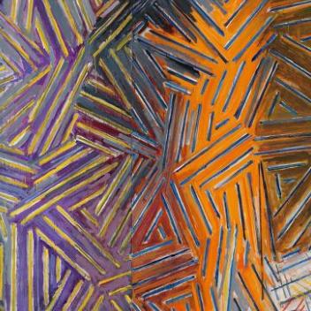
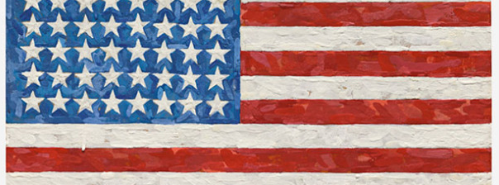

Slide 5
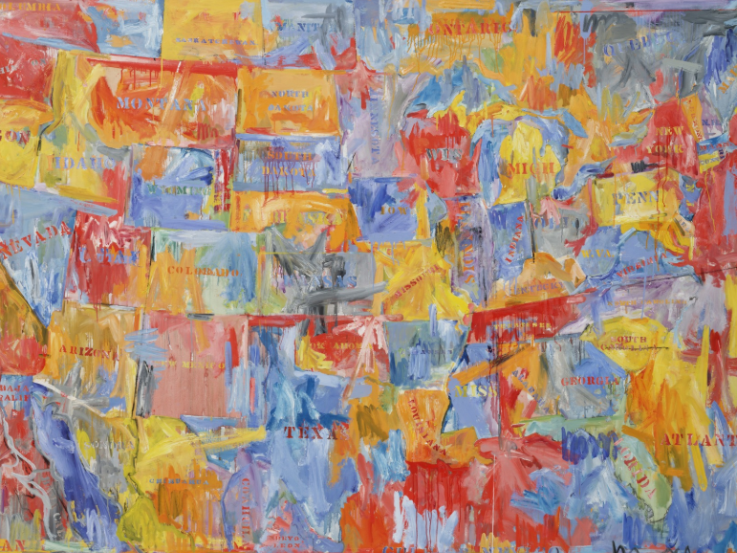
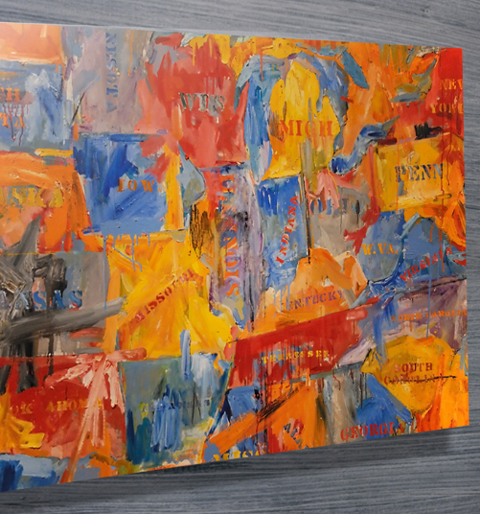

Slide 6
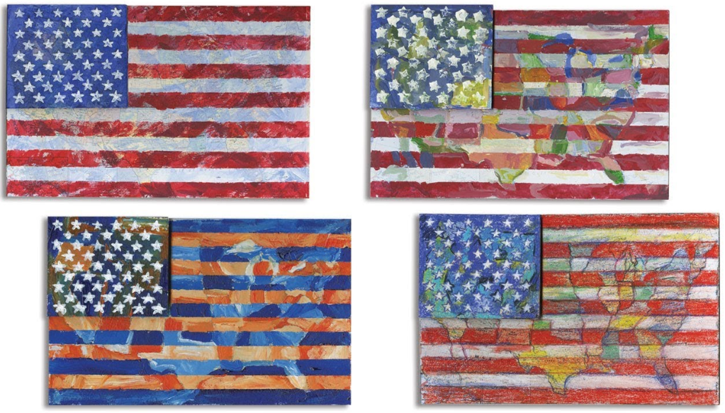

Slide 7
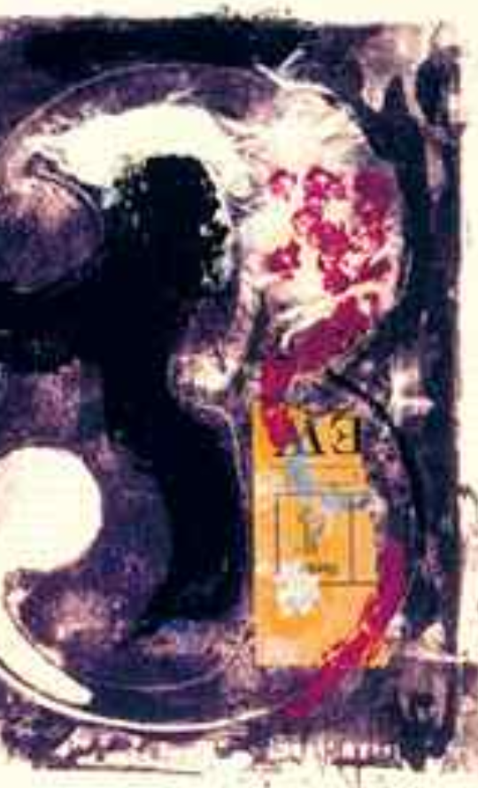
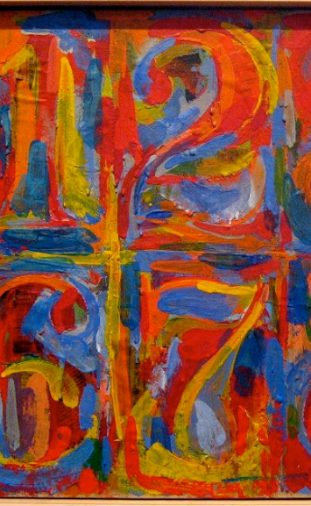
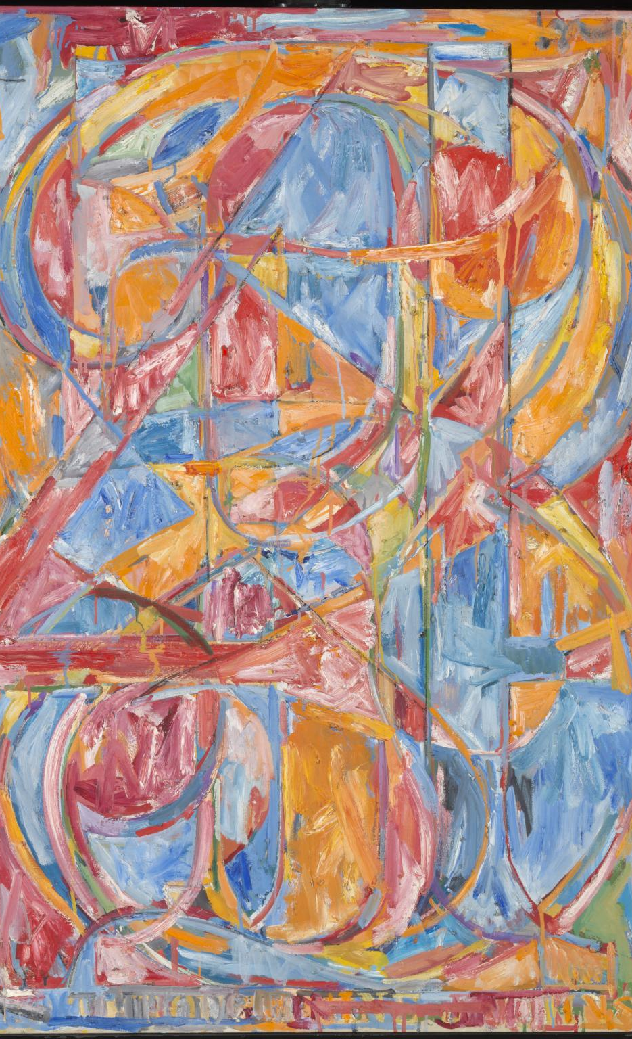

Slide 8
Branding Design

Slide 9
Colour Scheme
Pastel colours (soft and neutral) for heading text, button outlines, design trim/highlights
Similar to Jasper Johns artwork

Dark grey colour for window background, white canvas

Slide 10

Typography
Program typography will use ‘Hansief Rough’
Texture and shape is reminiscent of Jasper Johns’ style

Slide 11
Layout and interaction planning

Slide 12
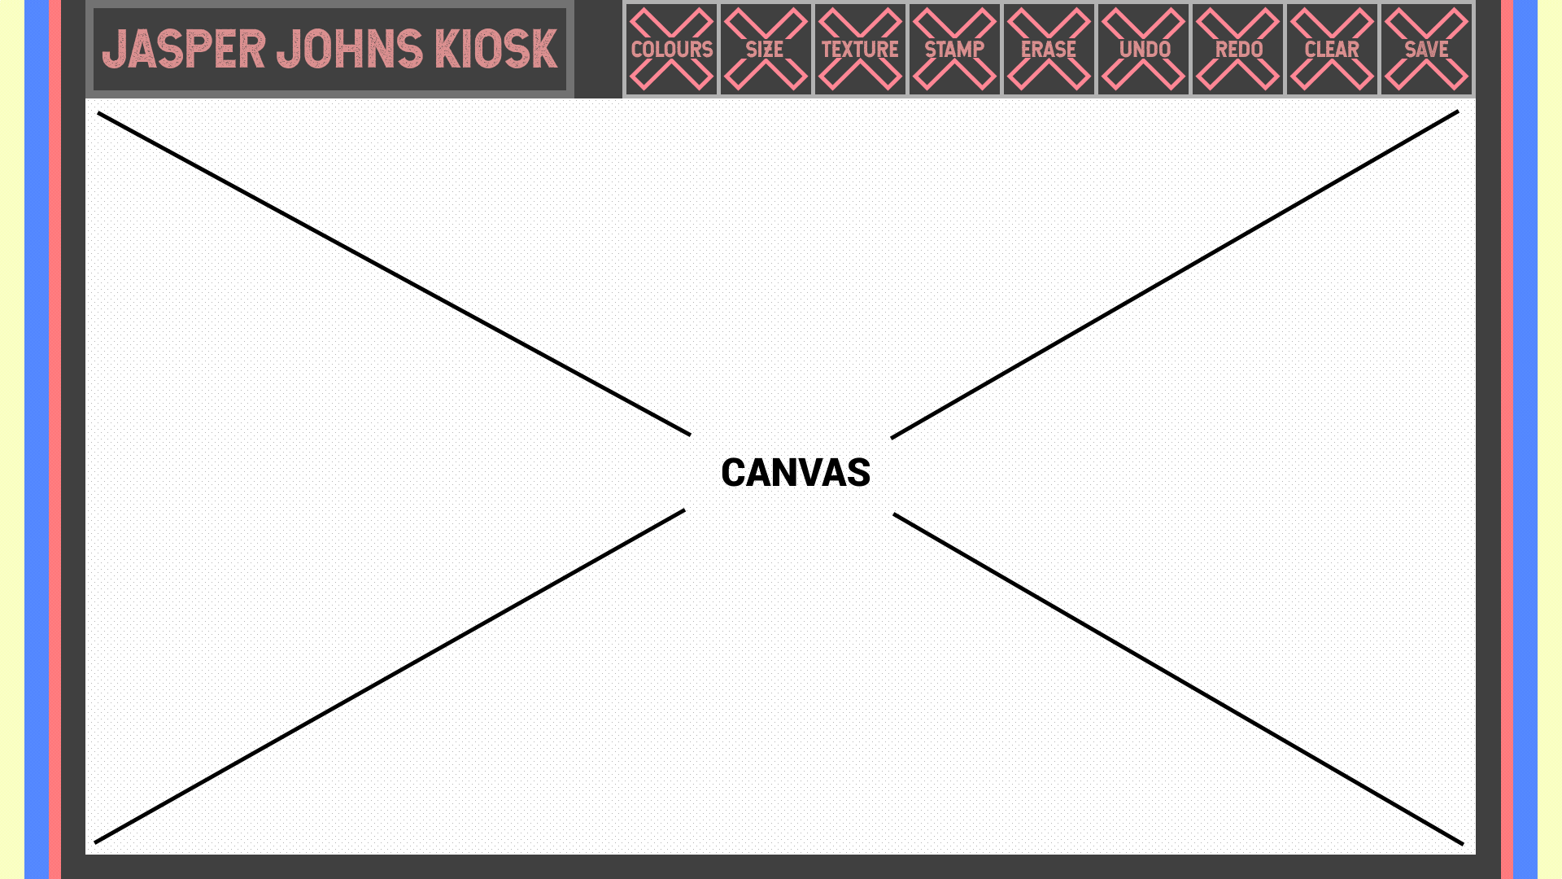

Slide 13
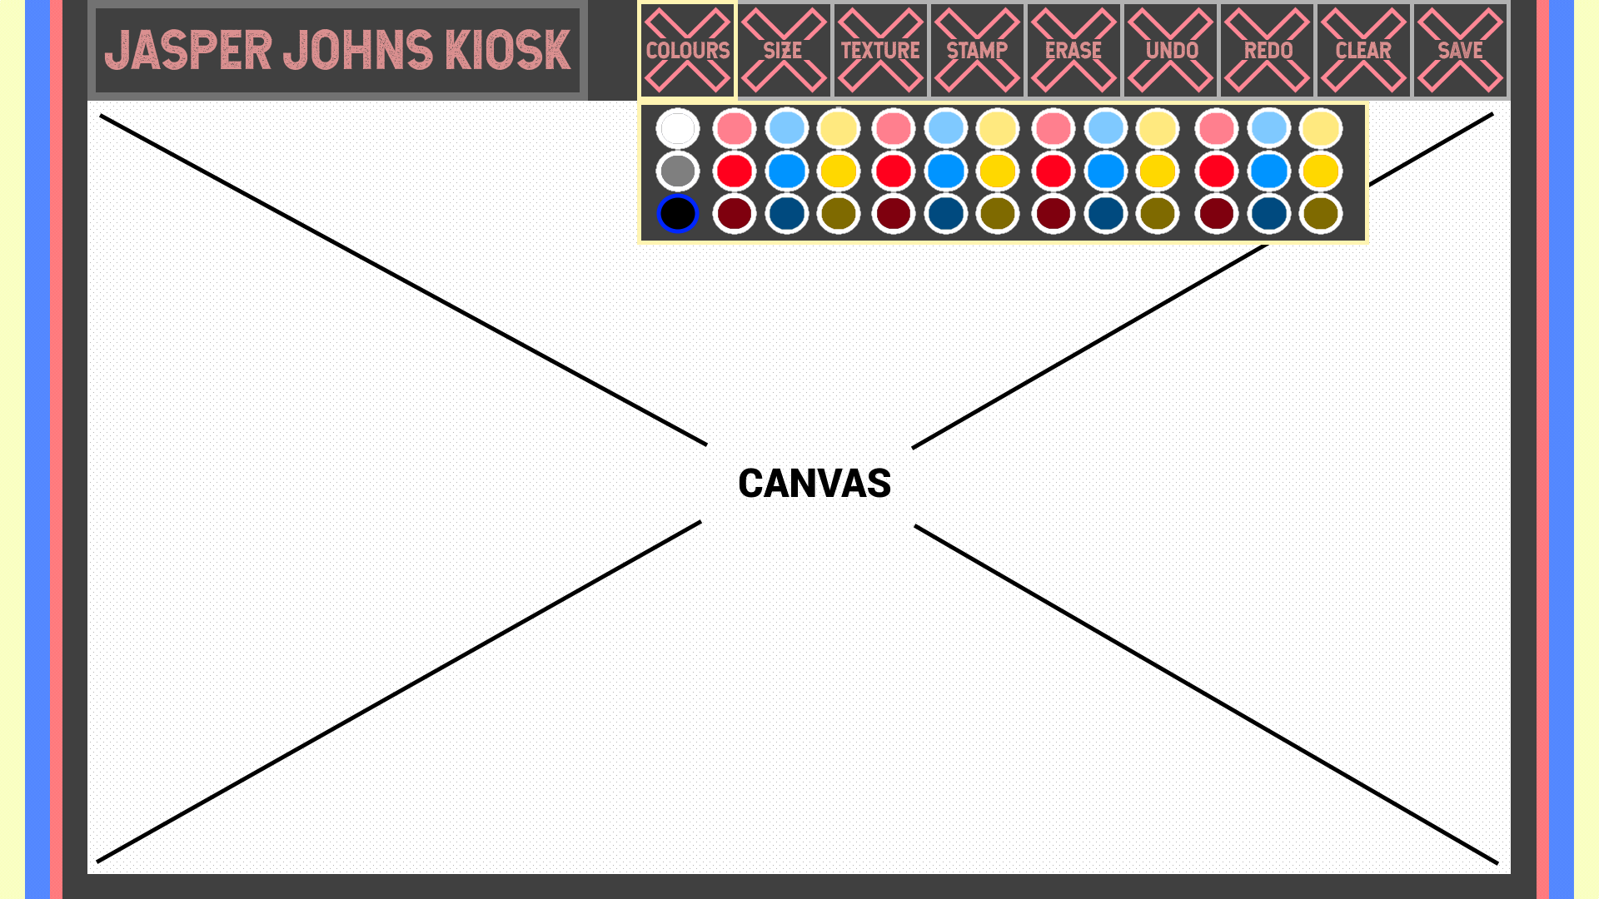
Interactive Element – Changing colour

Slide 14
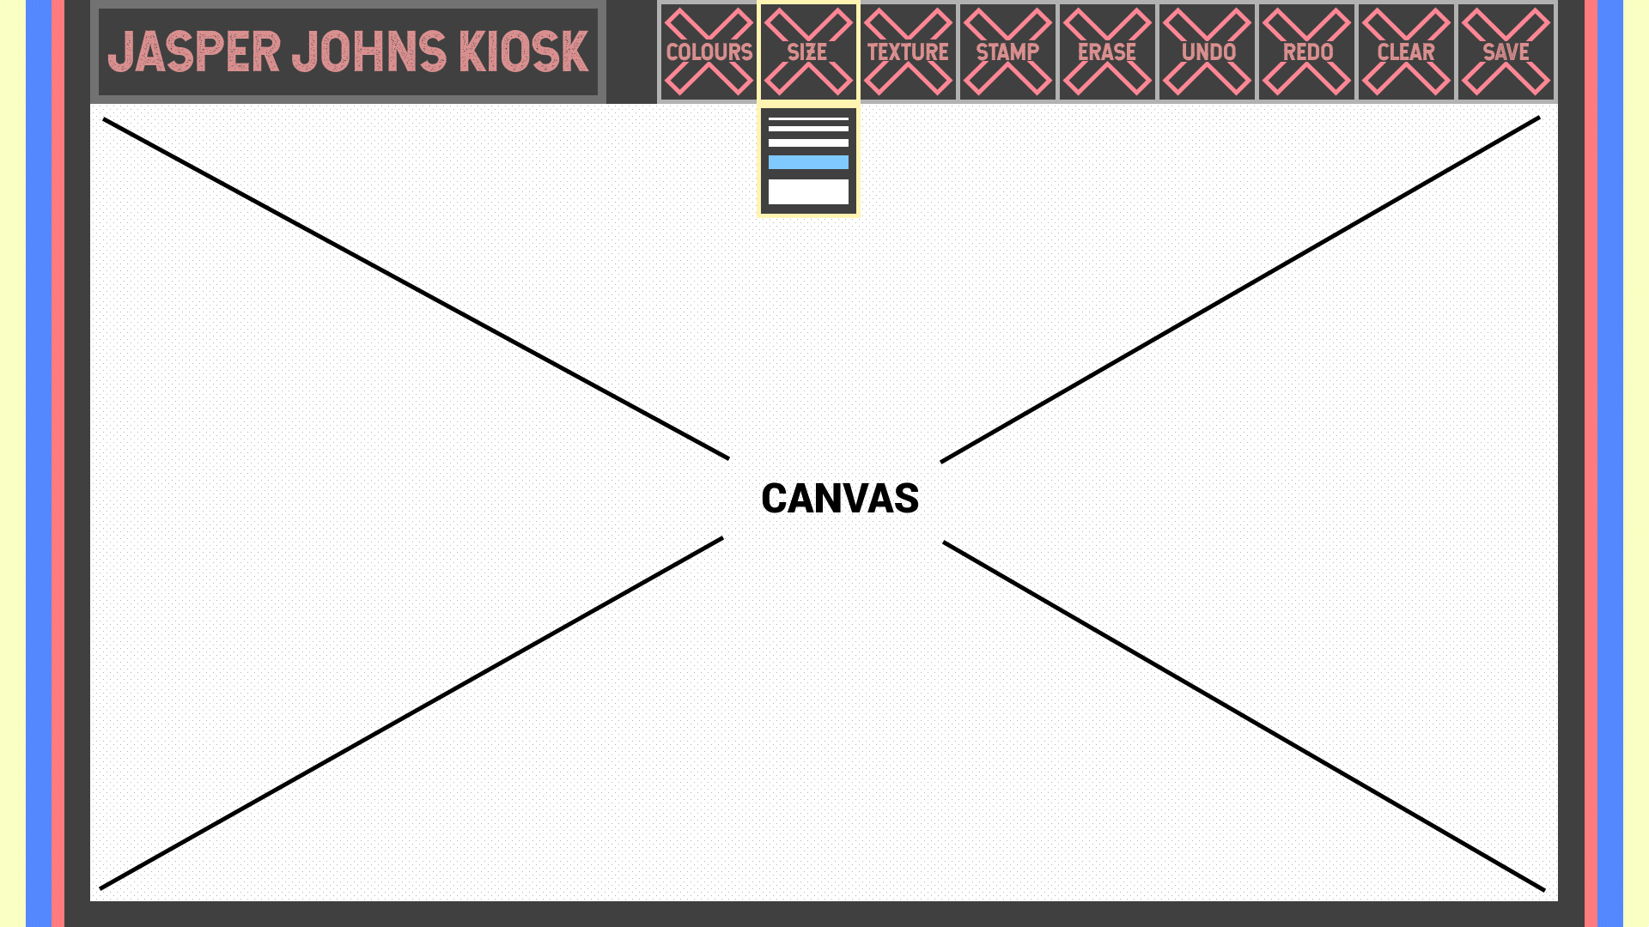
Interactive Element – Changing Brush Size

Slide 15

Other Interactive Elements
Changing the brush texture
Eg. Paint streak, aerosol spray, abstract
Adding a stamp
Eg. Stamp of Jasper Johns’ artwork
Fill, Erase, Undo, Redo, Clear
Save and Email image screenshot of canvas

Slide 16
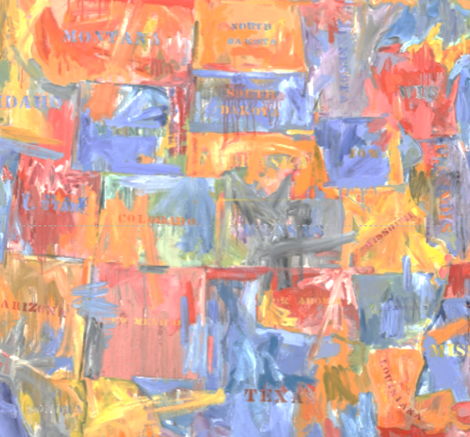
Map Stamps
Stamps with text input
White Textures
Dripping Textures
Text Stencils
Bright Colours
Dripping Paint

Slide 17
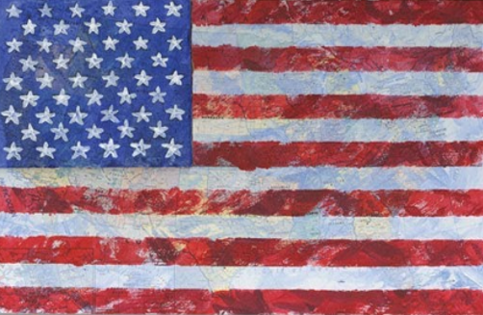

Flag Stamps
Layers
Picture Overlay
Opacity

Slide 18
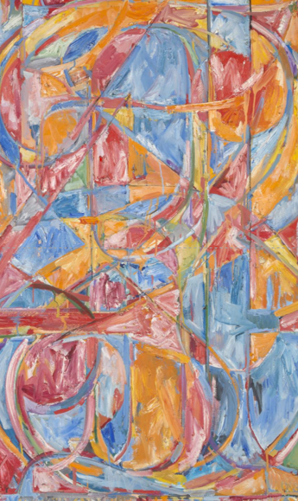

Number Stamps
Rainbow colour stroke
Fill bucket with op art textures
White Textures

Slide 19

Technical Considerations
Rainbow stroke – Consistency
Implementing layers – Advanced
Dripping Texture – Natural?

Slide 20
References
https://news.artnet.com/art-world/jasper-johns-wanted-young-people-to-see-his-art-the-broads-retrospective-has-pulled-it-off-1228133
http://www.jasper-johns.org/
https://www.biography.com/people/jasper-johns-9355664
https://artuk.org/discover/artists/johns-jasper-b-1930
https://www.thetimes.co.uk/article/visual-art-review-jasper-johns-something-resembling-truth-at-the-royal-academy-w1-zghg86g3h
http://www.artnews.com/2014/11/11/36-m-flag-sets-jasper-johns-record-at-sothebys-343-7-m-contemporary-art-auction/
https://www.moma.org/collection/works/78393
https://thewestologist.wordpress.com/tag/jasper-johns/
https://www.canvasprintsaustralia.net.au/product/jasper-johns-map/
https://www.tes.com/lessons/tWW1VQ4pcom_Ag/abstract-number-art-j-johns

